Slide 1

LAB SQL 05 Database(s): salesshort Lab goals. Use outer joins, unions, and self joins with either your local MySQL Community Server instance or the on-premise MySQL server at Leeds. If you use your local MySQL Community Server instance, you will need to load the salesshort database into your local instance using the .sql file: S02 salesshort.sql. Remember to select ‘Don’t Limit’ to ensure your query results are not being limited to the first 10, 50, 100 rows, etc…
If you are still troubleshooting any part of the MySQL installation process and/or connection to the MySQL server instance at Leeds, please reference this PowerPoint. You can also use MySQL in phpMyAdmin as a demo.
MSBX-5405
Originally created by: Dr. Karina Hauser
Modified by: Keith Sparling

Slide 2
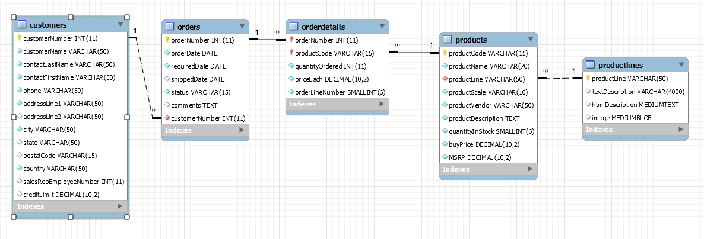
ER Diagram for SalesShort Database

Slide 3
LAB SQL 05 Save a .sql script labeled: lab05_”your IdentiKey” (for example: lab05_kesp5555)
Write SELECT statements to answer the following using left joins…
Show all customers (customerNumber and customerName) without any orders.
How many products (i.e., via a count) don't have an order?
Show all productlines (productLine and textDescription) that don’t have products.
How many customers (i.e., via a count) don’t have orders?

Slide 4
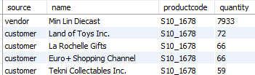
LAB SQL 05 Save a .sql script labeled: lab05_”your IdentiKey” (for example: lab05_kesp5555)
Write a SELECT statement to answer the following using a union…
Create a list with the following four fields:
under one column aliased name, combine both the customerName and productVendor fields together (i.e., mix your customers and vendors together in one column);
the productCode;
under one column aliased quantity, combine both the quantityOrdered (for customers) and the quantityInStock (for vendors) fields together; and
a new column labeled source as a calculated field that identifies (i.e., stamps) the table source (e.g., ‘customer,’ ‘vendor’) depending on where the information comes from. If the data comes from the customers table, stamp the string/text: ‘customer’. If the data comes from the products table, stamp the string/text: ‘vendor’.
Order by productCode (A-Z), then order by quantity (highest qty to lowest qty).
This SELECT statement is worth 2 points.

Slide 5
LAB SQL 05 Save a .sql script labeled: lab05_”your IdentiKey” (for example: lab05_kesp5555)
Write SELECT statements to answer the following using self joins…
Which country is ‘Rovelli Gifts’ in? Show all customers (including ‘Rovelli Gifts’) from that country to include their customerNumber, customerName, city, and country. Order by customerName (A-Z).
Determine the vendor for ‘1968 Ford Mustang’ and show the other products sold/offered by that vendor (do not include ‘1968 Ford Mustang’). Show the productCode, productName, and productLine of these other products. Order by productCode (A-Z).
Which products did ‘Boards & Toys Co.’ buy? Show the other customers (not including ‘Boards & Toys Co.’) who bought these same products. Show the customerNumber, customerName, productCode, and productName of these other customers. Order by productCode (A-Z). This SELECT statement is worth 2 points.
For initial help, you’ll use inner joins to join the customers, orders, orderdetails, and products tables. Then, you’ll use self joins with those same tables.

Slide 6
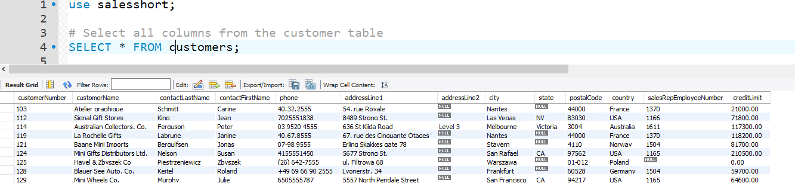
Submit the following:
One .sql file with your 8 SQL scripts.
OPTIONAL…a word document, PDF, or PowerPoint with screenshots of your SQL code and the first 10 - 20 lines of output for each of your 8 SQL scripts (i.e., select statements). Example:
This lab assignment will be reviewed by two peers, taking the average score from these two peer reviews, based on (1) the ability to execute/run each select statement and (2) the “recommended” output for each select statement.

